Slide 1



CCA GAME DEVELOPMENT
Space Shooter OOP
Mini Project 1
Module 1 — Session 4
Object-Oriented Programming & Game Architecture
Teacher: Annisa Hendrawan
Senior High School | Global Prestasi School

Slide 2


From Procedural Code to OOP
BEFORE
AFTER
PLAYER
player_x
player_y
player_speed
LASERS
lasers
laser_speed
ASTEROIDS
asteroids
asteroid_speed
GAME LOOP
move player
move lasers
spawn asteroids
move asteroids
collision
draw everything
Player Class
├── image
├── rect
├── speed
└── update()
Laser Class
├── image
├── rect
├── speed
└── update()
Asteroid Class
├── image
├── rect
├── speed
└── update()
Sprite Groups
├── all_sprites
├── lasers
└── asteroids
GAME LOOP
Events
↓
Create Objects
↓
Update
↓
Collision
↓
Draw

Slide 3


Today's Mission
Today, we will refactor our existing Space Shooter into a more organized OOP game.
Our 6 Big Ideas
01 — Refactoring
02 — Class
Organize existing code without changing its main behavior.
Create a blueprint for our game objects.
03 — Object
04 — __init__() & self
Create actual game objects from our classes.
Set up and manage an object's own data.
At the end:
We will have a more organized OOP version of our Space Shooter.
05 — Sprite Groups
06 — Delta Time
Manage many game objects together.
Make movement depend on elapsed time.

Slide 4
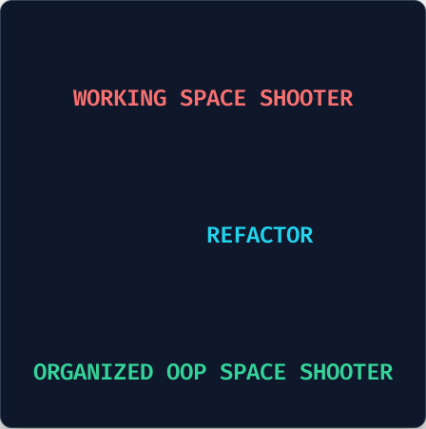

Mini Project 1: Space Shooter OOP
We already have a working Space Shooter.
architecture.txt
Today, we will change its code structure, not its main game idea.
Our game still needs to:
→
Move the Player
→
Move objects
→
Shoot Lasers
→
Detect collisions
→
Spawn Asteroids
→
Keep running in a Game Loop

Slide 5

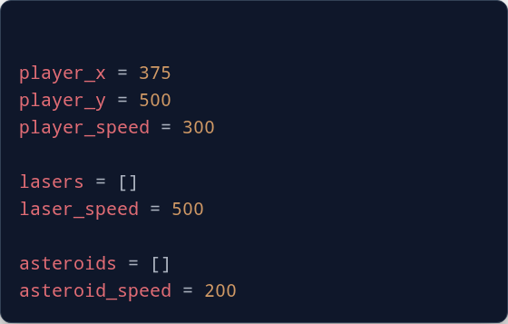

Look at the Existing Code
A simple Space Shooter may store game data like this:
And the main game loop controls:
Player movement
Laser movement
Asteroid movement
Asteroid spawning
Collision
Drawing
main.py
Question
What happens when our game gets bigger?

Slide 6

Big Idea #1: Refactoring
What Is Refactoring?
Refactoring means reorganizing existing code without changing its intended behavior.
We are changing the structure, not the main game idea.
Our goal:
→
Organize the code
→
Make responsibilities clearer
→
Make the game easier to expand

Slide 7
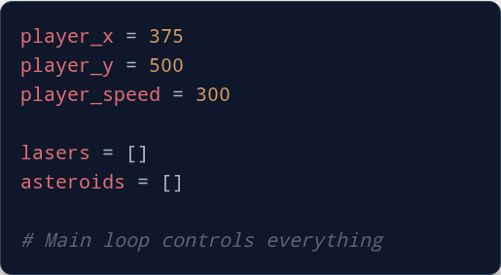
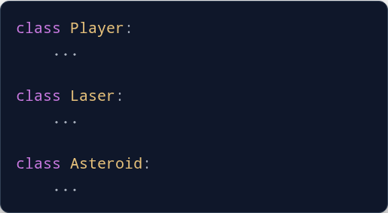
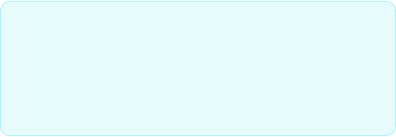
From Procedural Code to OOP
BEFORE
AFTER
What changed?
Main idea
Before: Different game objects are mixed together.
Each part of the game gets a clear responsibility.
After: Each game object has its own structure.

Slide 8
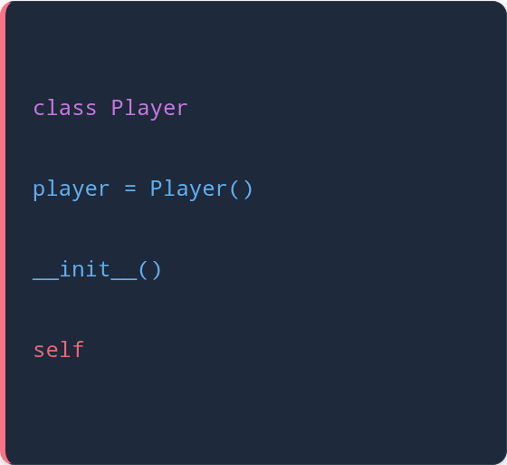
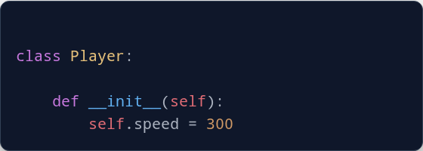

Organizing a Game Object
A class is a blueprint.
Remember
An object is the actual thing created from that blueprint.
→ Blueprint
→ Object
→ Initial setup (initialize)
Create the object:
→ The current object

Slide 9


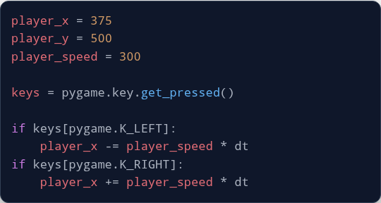
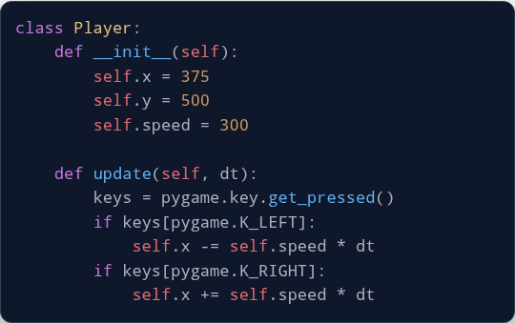
Refactoring the Player
BEFORE
AFTER
Before: Player data and behavior are in the main program.
What changed?
After: Player data and behavior are inside the Player class.
player_x → self.x player_y → self.y player_speed → self.speed

Slide 10
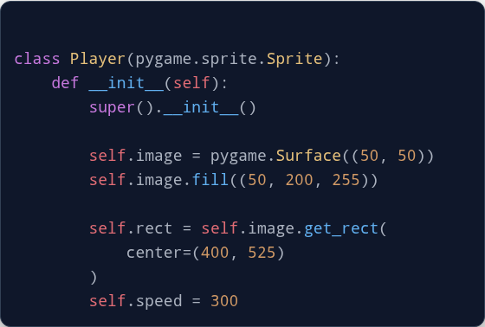

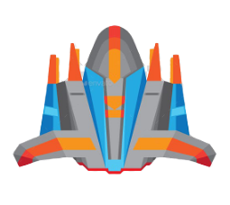
Turning the Player into a Sprite
A Pygame Sprite is a game object that Pygame can manage.
pygame.sprite.Sprite
Pygame's base Sprite class
Key parts:
super().__init__()
Initialize parent Sprite
image
Sprite's appearance
rect
Position and area

Slide 11
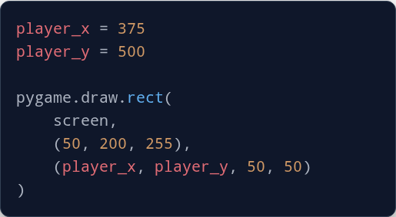
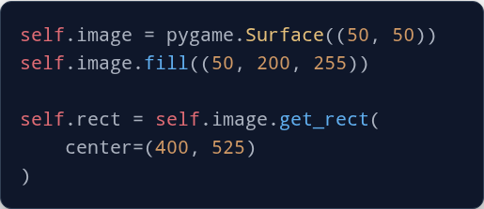

From Manual Drawing to Sprite
BEFORE
AFTER
Before: We manually draw the Player using coordinates.
After: The Sprite stores its image (Appearance) and rect (Position).
Now Pygame can manage the Player as a Sprite.
What changed?

Slide 12


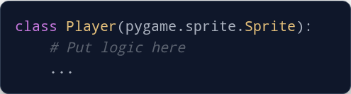
Your Turn: Refactor the Player
Open your existing Space Shooter. Move the Player-related code into the class.
1. The Structure
2. Include Attributes
→
Player starting position
→
Player speed
→
Player movement
→
image
→
rect
Then test: Does the Player still move correctly?

Slide 13

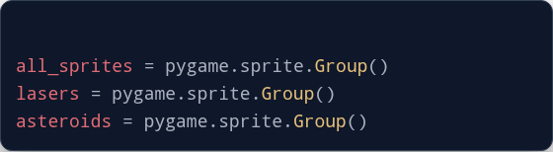
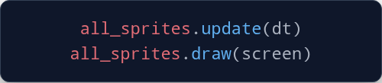

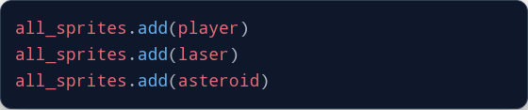
Big Idea #5: Sprite Groups
Managing Many Game Objects
A Sprite Group is a container that manages multiple Sprites.
Then manage them together
Add objects:
Main idea
Group = manage many Sprites together

Slide 14


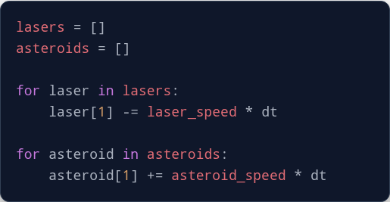
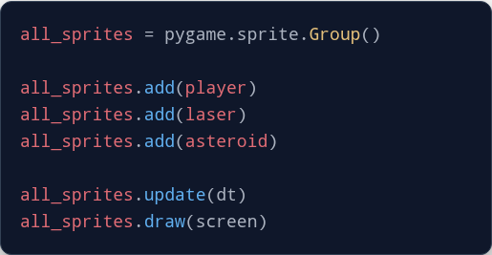

Managing Many Objects
BEFORE
AFTER
Before: We manually manage different lists and loops.
After: The Sprite Group helps manage our Sprites together.
What changed?

Slide 15






Big Idea #6: Delta Time
Making Movement Time-Based
BEFORE
dt = Delta Time.
Delta means difference or change.
AFTER
dt tells us how much time passed between frames.
What changed?
Before: Movement depends on frames.
For movement:
After: Movement depends on elapsed time.
movement = speed * dt
Speed × Time = Movement

Slide 16
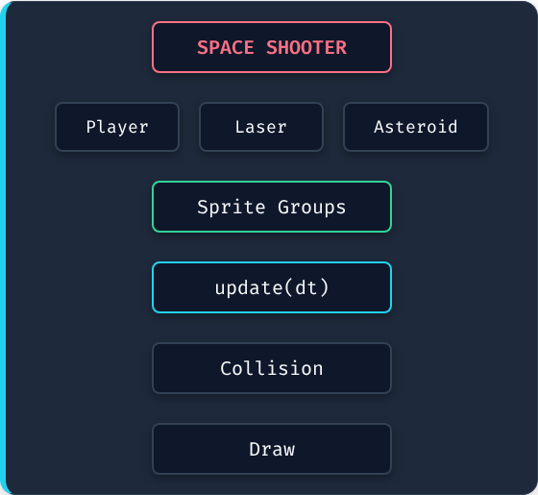

Space Shooter OOP Architecture
The Main Game Loop
The main game loop now focuses on high-level logic:
1. Events
↓
2. Create Objects
↓
3. Update
↓
4. Collision
↓
5. Draw

Slide 17

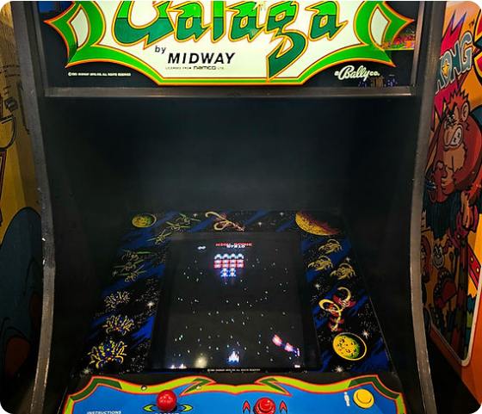

Refactor Your Space Shooter
Now apply the ideas to your own existing game.
Required:
→
Player class
→
Sprite Groups
→
Laser class
→
update(dt)
→
Asteroid class
→
Delta Time
→
Pygame Sprites
→
Working collision
Important
Your game should still work after refactoring.

Slide 18



Customize Your Space Shooter
Once your OOP structure works, make the game your own.
Change
Add
→
Player design
→
Score
→
Laser design
→
Lives
→
Asteroid design
→
Power-ups
→
Movement speed
→
New enemies
→
Spawn rate
→
Sound effects
→
Background
→
New weapons

Slide 19




Final Recap: The 6 Big Ideas
01 — Refactoring
02 — Class
03 — Object
Reorganize existing code cleanly.
A blueprint for game objects.
An actual thing created from a class.
04 — __init__() & self
05 — Sprite Groups
06 — Delta Time
Set up and manage an object's own data.
Manage many Sprites together.
Make movement depend on elapsed time.

Slide 20


THINK LIKE A GAME DEVELOPER
When your game becomes bigger, ask:
"Who should be responsible for this?"
Player movement → Player
Manage many Sprites → Sprite Group
Laser movement → Laser
Asteroid movement → Asteroid
Time between frames → dt
Good game architecture means:
Each part of the game has a clear responsibility.

